Slide 1
Topology optimization of a stress constrained and minimal compliance problems using MATLAB
Alexander Shumilov, IST

Slide 2
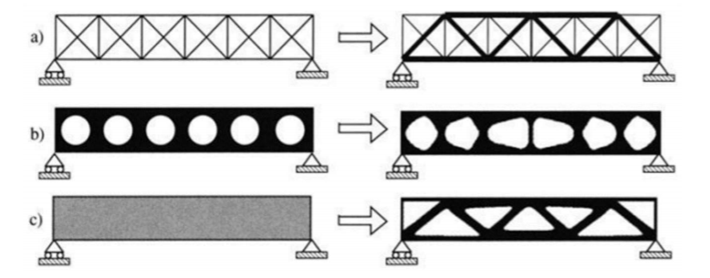
Categories of structural optimization
a) Sizing optimization of a truss structure, b) shape optimization, and c) topology optimization. The initial problems are shown at the left hand side and the optimal solutions are shown at the right [2].

Slide 3
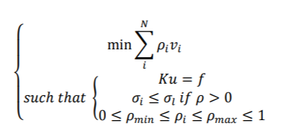
Stress constrained problem
N is the number of elements, ρ is the density (and also the design variable), ρi is the elemental density, vi is the elemental area/volume, K is the stiffness, u is the displacement, f is the external force, σi is the elemental stress measure, σl is the stress limit [1]

Slide 4
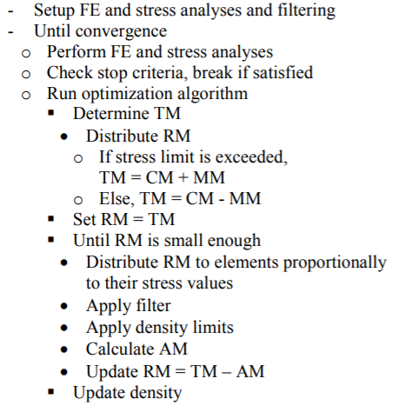
Algorithm for stress constrained problem
TM is the target material amount
CM is the current material amount
MM is the material move amount
RM is the remaining material amount
AM is the actual material amount.

Slide 5
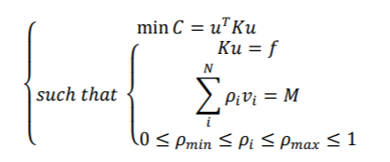
Minimal compliance problem
N is the number of elements, ρ is the density (and also the design variable), ρi is the elemental density, vi is the elemental area/volume, K is the stiffness, u is the displacement, f is the external force, σi is the elemental stress measure, σl is the stress limit, C is the compliance and M is the total mass [1]

Slide 6
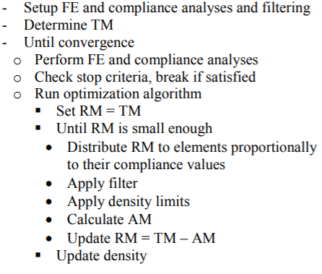
Algorithm for minimal compliance problem
TM is the target material amount
CM is the current material amount
MM is the material move amount
RM is the remaining material amount
AM is the actual material amount.

Slide 7
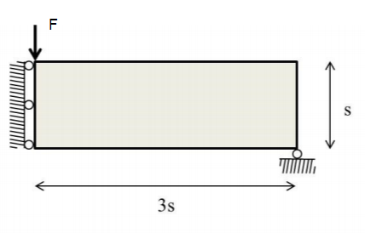
MBB-beam

Slide 8
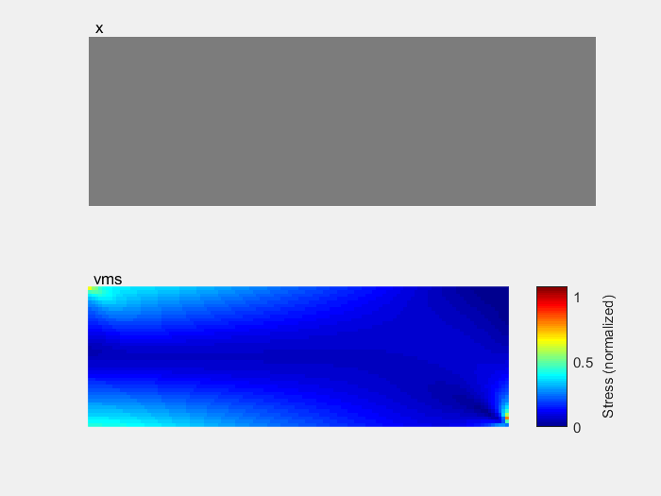
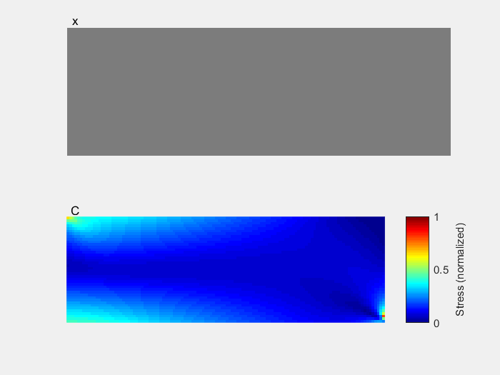
Results (MATLAB)
Stress constrained problem
Minimal compliance problem

Slide 9
Reference list
Biyikli, Emre & To, Albert. (2014). Proportional Topology Optimization: A new non-gradient method for solving stress constrained and minimum compliance problems and its implementation in MATLAB. PLOS ONE. 10. 10.1371/journal.pone.0145041.
Grinde, Seth. (2018). TOPOLOGY OPTIMIZATION FOR ADDITIVE MANUFACTURING USING SIMP METHOD.
Challis, V. J. (2009). A discrete level-set topology optimization code written in Matlab. Structural and Multidisciplinary Optimization, 41(3), 453–464
París, José & Navarrina, F & Colominas, Ignasi & Casteleiro, M. (2008). Advances in the statement of stress constraints in structural topology optimization.

Slide 11
Appendix

Slide 12
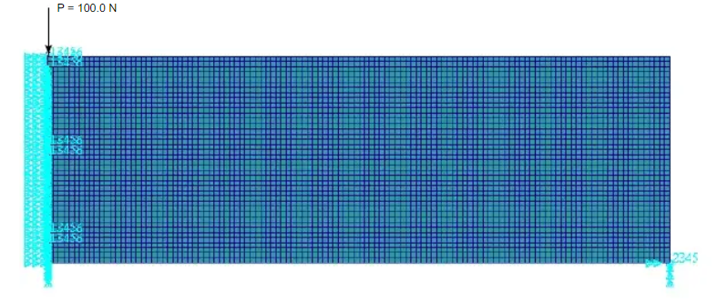

Slide 13
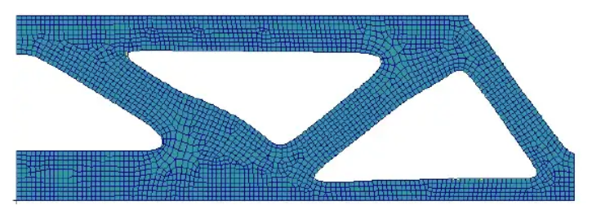

Slide 14
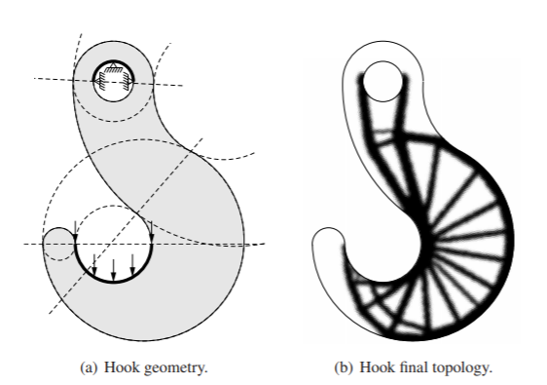

Slide 15
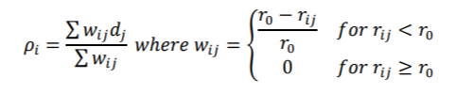
ρi is the filtered density of element i, wij is the filtering weight of elements i and j, dj is the non-filtered density of element j, rij is the distance between elements i and j, and r0 is the filter radius. The weight is inversely proportional to the distance between the element and its neighbors. In this sense, the cone density filtering is actually nothing but local averaging

Slide 16
Filtering is endorsed to be advantageous for many reasons:
Small scale features such as jagged edges, narrow members, and sharp interfaces are prevented.
As a result of smoothing, a blurred region around the structural members is obtained.
The algorithm is saved from getting stuck in local minima.

Slide 17
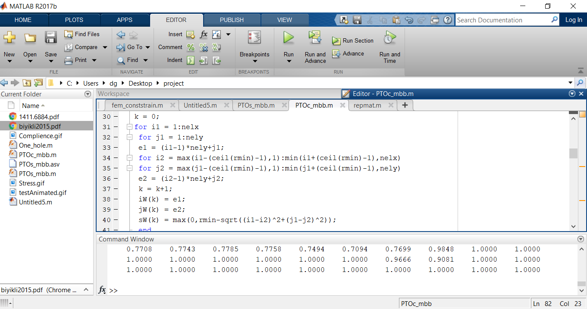

Slide 18
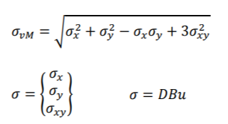
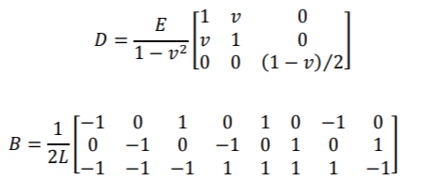
D is the constitutive matrix, B is the shape function derivative matrix, and u is the displacement vector.

Slide 19
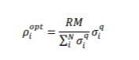
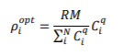
RM is the remaining material amount, N is the number of elements, ρi opt is the optimized elemental density, σi is the elemental stress measure, Ci is the elemental compliance value and q is the proportion exponent.

